Slide 1
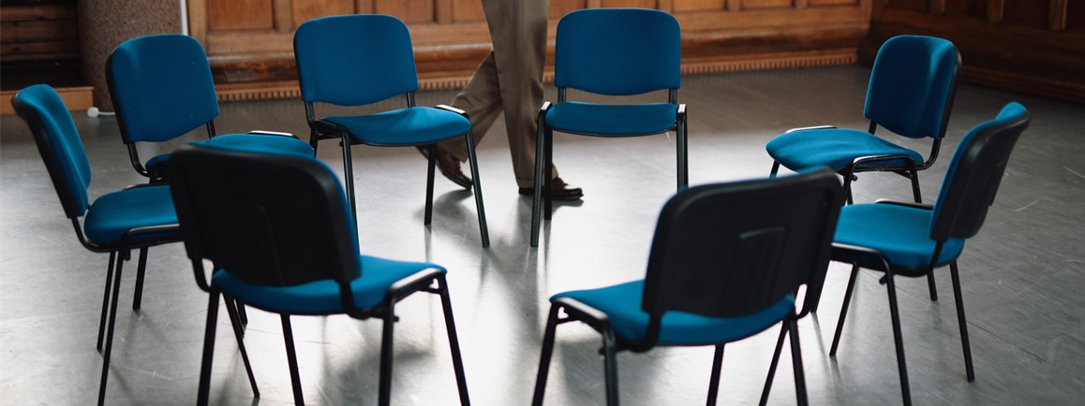
For we have many members in one body, but not all the members have the same function. In the same way, we who are many are one body in Christ, and are individually members of each other. We have different gifts according to the grace that was given to us (Rom. 12:4-6a).
Now there are different gifts, but the same Spirit. There are different ministries, but the same Lord; and there are different kinds of work, but it is the same God who works all in all (1 Cor. 12:4-6).
All Scripture taken from the English Unlocked Literal Bible (ULB), ©2017, 2022 Wycliffe Associates, Available at https://bibleineverylanguage.org/translations, licensed under the Creative Commons Attribution-ShareAlike 4.0 International License.
The English ULB is based on the unfoldingWord® Literal Text, CC BY-SA 4.0. The original work of the unfoldingWord® Literal Text is available at https://unfoldingword.bible/ult/.
Building Teams and Harnessing Skills

Slide 2
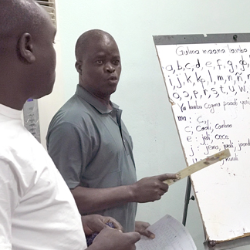
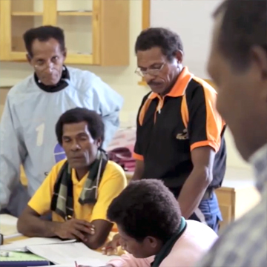
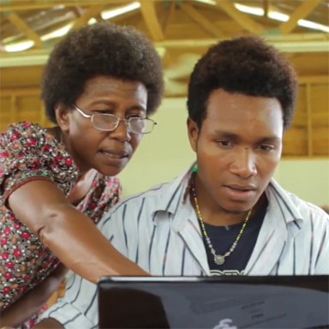
Team Skills Inventory
GL ability
HL ability
Bible knowledge
Tech Knowledge
Background
Personality
Thinking Style
Form teams that work well together
What needs prevent translator focus?
How will workshop leaders provide for these needs?

Slide 3
Zone of Proximal
Development
Team Skills Inventory
3-circle drawing for ZPD
  A learner increases his skill by working with someone 1 step ahead.
  An outer ring of skill is still beyond learner.
Example of ZPD—baby learning to walk; learning to ride a bike.
  Learners do better with someone who will meet them in the middle circle..
Picture of scaffolding
  Learners receive support like a scaffold in layers so they can reach higher.
Teams Skills Inventory helps leaders form teams of translators that can work well together.
  Should be done at beginning of workshop.
  Group translators with others of similar skill level.
  Skills assessed: GL ability, HL ability, Bible knowledge, Tech Knowledge, thinking style.
What kinds of needs might keep translators from focusing on work?
How do leaders at a MAST event help provide for these needs so translators can learn and work?
ZPD
Learner can do
with guidance
Learner
can do
unaided
Learner cannot do

Slide 4
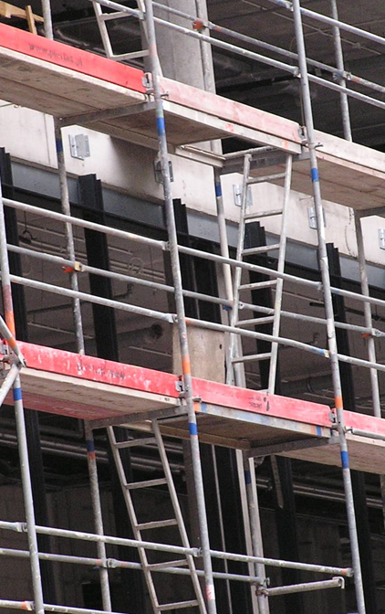
Scaffolding
Process of training students by providing support
to reach higher
Notes:
Automatic build

Slide 5
Assessing Translators for Group Placement
1
2
3
Lower skilled
translators
supported
for the ZPD
“mid-circle”
Lower skilled translators
with
advanced translators
Scaffold
Notes:
Click to build each number

Slide 6


Personality Shapes
What’s Your Shape?

Slide 7
Thinking Style
Which traits best describe you?
Left Brain:
Uses logic
Detail oriented
Facts rule
Words & language
Present & past
Math & science
Right Brain:
Uses feeling
“Big picture” oriented
Creative problem solver
Imagination rules
Symbols & images
Present & future
Philosophy & religion
Notes:
Automatic build

Slide 8
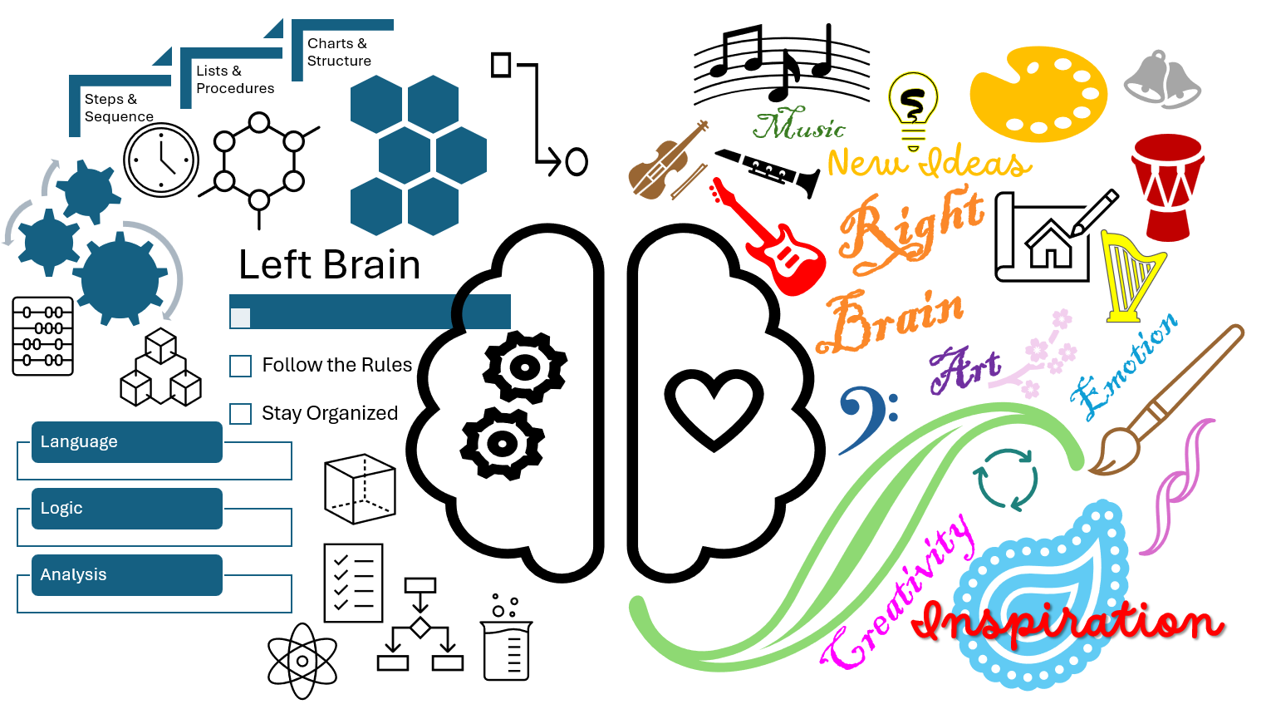
Thinking Style
  Which pictures best describe you?
  Which side of the brain fits you better?
Notes:
Automatic build

Slide 9
Building Teams
1
2
3
Lower skilled
translators
supported
for the ZPD
“mid-circle”
Lower skilled translators
with
advanced translators
Scaffold
4
5
Leader:
regroup if needed
Variety of
thinking styles
and
personalities
Notes:
Click to build each number

